Slide 1


PLACE CUSTOMER LOGO HERE
Migrating with Debezium
Mike Fowler - Senior Site Reliability Engineer, Public Cloud Practice

Slide 2







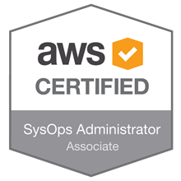

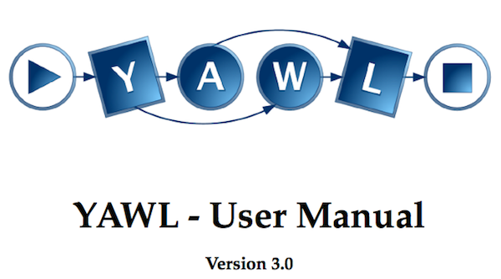











About Me
Notes:
Senior Site Reliability Engineer in the Public Cloud Practice
Background in Software & Systems Engineering, System & Database Administration
Using PostgreSQL since version 7.4
Contributed to PostgreSQL, Terraform & YAWL
Been involved with flossUK, formerly UKUUG for many years first reviewing books and then as a speaker
Work exclusively on public clouds, hence the collection of Public Cloud certifications

Slide 3
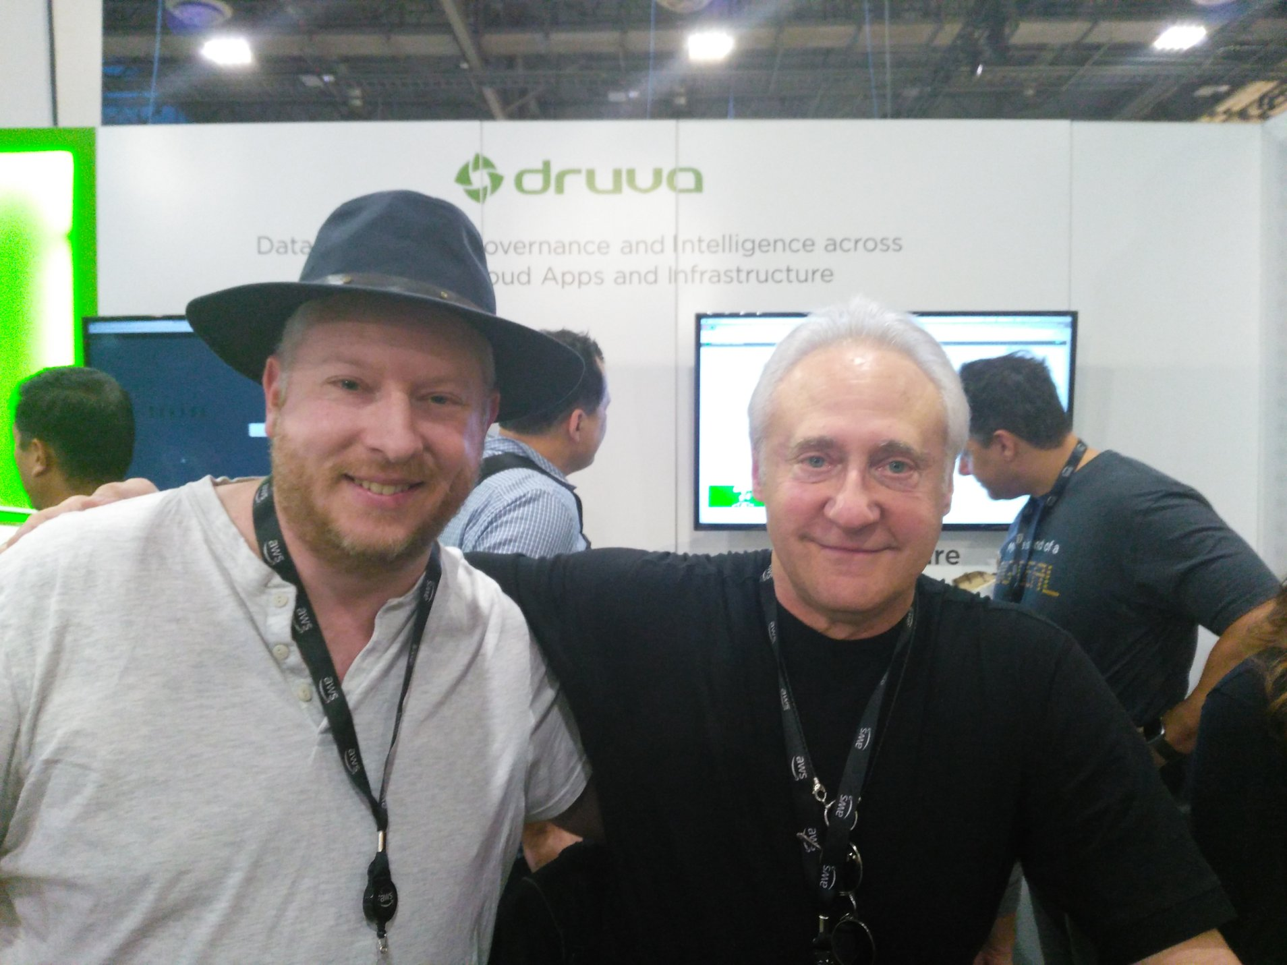
Notes:
Image Source: Author’s personal collection
“As you can see from my background, I like to think that I know Data”

Slide 4

Assess
Notes:
Image Source: https://wall.alphacoders.com/big.php?i=789452
Identify what requires migration
Database schemas
Client applications
Analyse for PostgreSQL compatibility
In each schema we need to convert
Storage Objects
Tables, views, data types, etc.
Code Objects
Packages, procedures & functions
Most projects are qualified out at this stage

Slide 5

Refactor
Notes:
Image Source: https://www.coventrytelegraph.net/news/uk-world-news/big-ben-scaffolding-14826151
Determine what needs to be migrated
Whole schemas may no longer be required
Some tables could be archived out of the database
Extract tables to a data interchange format and store in Google Cloud Storage or S3
Some packages/procedures/functions could be removed
Rewrite stored procedures and functions to PL/PgSQL or equivalent
Test Driven Compatibility Development
Existing bugs may be identified
Preserving them may be necessary, and hard
Fixes should be retrofitted so that switchover day surprises don’t occur

Slide 6

Migrate
Notes:
Image Source: https://www.amazon.com/Battlestar-Galactica-Fleet-Poster-2ftx3ft/dp/B005E9JWTW
Migration of test database will commence with the refactoring
Final migration of the production database occurs after:
All refactorings are complete
The migration has been performed multiple times
The applications have been tested against a pre-migrated production database

Slide 7



How do we get from A to B?
Notes:
Two primary approaches
Extract,Transform & Load (also called Dump & Restore)
Change Data Capture & Replay
Picking on MySQL but MongoDB and PostgreSQL itself can also be sources
Oracle & SQL Server are in development

Slide 8

Option: CSV Extract, Transform & Load
Notes:
Simplest strategy
Perceived as low risk for data loss
Less “moving parts”
Easy to test repeatedly and “prove” migration
Downtime is function of database size
Downtime can be minimised
Move historic data ahead of time
Opportunity to clear out unused data
Consider introducing partitions
Over provision resources
Gives higher throughput during data load
Downscale once operational

Slide 9

Option: Initial Load + Change Data Capture
Notes:
Usually a complicated option that requires connected two unrelated technologies
The same ETL as the CSV approach needs to be performed, but continually and reliably
Failures often require a complete restart of the process to ensure no data loss
Numerous commercial offerings but few open source
Enter Kafka
Append only log journaling system with messaging semantics
Entire history can be maintained if you’ve the disk space
Consumers maintain their position allowing for data replay in the event of failure

Slide 10

Option: Initial Load + Change Data Capture
connect
jdbc
Notes:
Kafka Connect is an extensible framework for producers and consumers
Debezium is a Kafka Connect source
Configured to read from MySQL and write to Kafka
Each table becomes it’s own topic with a dedicated topic for schema changes
The data and schema can be recorded in Kafka in Avro format using open source tools from Confluent
Kafka Connect JDBC is both a Kafka Connect source and sink, we’ll use it to sink data to PostgreSQL
We need to create one connector for each table topic to write to PostgreSQL
Able to read the schema data and create a corresponding table to host the incoming data

Slide 11
Ingredients
Kafka
Confluent
  Schema Registry
  Kafka Connect JDBC
Debezium
MySQL Database (Sakila)
PostgreSQL
Notes:
All of this software is open source however configuring and building the Confluent tools is involved
Working demonstration using Vagrant is available in GitHub (github.com/gh-mlfowler/debezium-demo)
We’ll walk through the interesting pieces of configuration to give an idea of what is involved and how easy it is to get data moving

Slide 12

Setting up MySQL
mysql -e "CREATE DATABASE sakila;"
mysql -e "CREATE USER sakila IDENTIFIED BY 'sakila';"
mysql -e "GRANT ALL PRIVILEGES ON *.* TO sakila;"
mysql -u sakila -psakila sakila < sakila-schema.sql
mysql -u sakila -psakila sakila < sakila-data.sql
https://dev.mysql.com/doc/sakila/en/
Notes:
The MySQL installation is the basic default available in Ubuntu
A database and user is created, all using the ‘sakila’ identifier
The Sakila (https://dev.mysql.com/doc/sakila/en/) sample database is loaded
Binary logging is not enabled so there is no change data capture available for this data

Slide 13
Setting up MySQL
server-id = 2019
log_bin = /var/log/mysql/mysql-bin.log
binlog_format = row
binlog_row_image = full
Notes:
Now the data is loaded we enable binary logging
We need a unique server-id to identify this server, we’ll need another one later
MySQL is restarted and any new changes are now recorded in the binary log

Slide 14
Setting up PostgreSQL
psql -c "CREATE USER sakila WITH PASSWORD 'sakila';"
psql -c "CREATE DATABASE sakila OWNER sakila;"
Notes:
Again, vanilla PostgreSQL as found in Ubuntu
Just a database and a user which owns the database
No schema is loaded, we just leave the empty database to be populated by JDBC Connect later

Slide 15
Setting up Debezium
{ "name": "mysql-connector",
"config": {
"Connector.class": "io.debezium.connector.mysql.MySqlConnector",
"database.hostname": "192.168.100.8",
"database.port": "3306",
"database.user": "sakila",
"database.password": "sakila",
"database.server.id": "184054",
"database.server.name": "mysql",
"database.whitelist": "sakila",
"database.history.kafka.bootstrap.servers": "127.0.0.1:9092",
"database.history.kafka.topic": "dbhistory.sakila",
"include.schema.changes": "true" }
}
Notes:
Each Kafka connector is defined by a JSON document passed to a web service
Items highlighted in red are what we likely need to change for each new connector
We need a unique database.server.id so Debezium can identify itself to the MySQL instance
A whitelist allows us to pick only the database or databases of interest

Slide 16
Adding the Debezium Kafka Connector
curl -X POST
-d @mysql.json
http://localhost:8083/connectors
--header "Content-Type:application/json"
Notes:
A POST with the JSON document as the body will create the connector and we can remove it later with a DELETE
Once the connector is created, it will interrogate MySQL to extract the schema
This requires a brief database wide lock but the timing is short and logged - check this for your planning!
All data older than the current binary log is read and transferred to Kafka
A topic is created per table
A topic recording schema changes is created
A second history table is created and is really for internal use

Slide 17
Verifying What’s Happened
# ./kafka-topics.sh --list --zookeeper localhost:2181
...
dbhistory.sakila
mysql
mysql.sakila.actor
mysql.sakila.address
mysql.sakila.category
mysql.sakila.city
...
Notes:
We can verify this by browsing our Kafka box and listing the topics
The topic names follow the pattern “server-name.database.table”
Server name is “mysql” in this example. This topic has the schema changes

Slide 18
Interlude: The Story so Far
Notes:
At this stage all existing data is resting in topics in Kafka
New changes to MySQL will be appended to Kafka shortly after they occur
DDL changes to the server name topic
Data changes to the relevant table topic
Although PostgreSQL is running, no data has been sent there yet

Slide 19
Setting up Kafka Connect JDBC
{ "name": "psql-sakila-sink-actor",
"config": {
"connector.class": "io.confluent.connect.jdbc.JdbcSinkConnector",
"tasks.max": "1",
"topics": "mysql.sakila.actor",
"connection.url":
"jdbc:postgresql://192.168.100.9:5432/sakila?user=sakila&password=sakila",
"transforms": "unwrap",
"transforms.unwrap.type": "io.debezium.transforms.UnwrapFromEnvelope",
"auto.create": "true",
"insert.mode": "upsert",
"table.name.format": "actor",
"pk.fields": "actor_id",
"pk.mode": "record_value" } }
Notes:
Configuring the Kafka Connect JDBC sink is similar to Debezium
Create one for each table we wish to sink or read multiple in a single connector
In this example we’ll consume only the actor table
If the table name isn’t specified the topic name will be used which PostgreSQL will reject

Slide 20
Adding the Kafka JDBC Connector
curl -X POST
-d @jdbc.json
http://localhost:8083/connectors
--header "Content-Type:application/json"
Notes:
Loading the JDBC connector is identical, just a POST to the Kafka Connect web service

Slide 21
Tada!
connect
jdbc
Notes:
All finished, end to end replication of data in near real time from MySQL to PostgreSQL
We can create many replicas simply by reading from the topics
One off read from the source database as long as Kafka is large enough to store all the data

Slide 22

No such thing as a ...
Notes:
Image Source: https://eguidemagazine.com/theres-no-such-thing-as-a-free-lunch/
With the simplicity of set-up we lose some things
Constraints are not copied across
These can be added at the time of the final switchover however you’ll need to time this to measure the impact
Data types are converted to the lowest common denominator
You can pre-create the schema to hand nominate the conversion
Does not deal with stored procedures
There are some tools for this, but this isn’t the tool for it

Slide 23







Questions ?
Mike Fowler www.mlfowler.com
mlfowler mlfowler_
github.com/gh-mlfowler/debezium-demo
mike.fowler@claranet.uk

Slide 24


